Slide 1

Barrett’s Project Portfolio
Author: Barrett Caywood
Date: 4-1-24

Slide 2
LAMP Stack

Slide 3
LAMP STACK Information
Description:
The LAMP stack is a popular open-source web platform used for building and hosting dynamic websites and web applications. It consists of four main components: Linux (the operating system), Apache (the web server), MySQL (the database management system), and PHP (the programming language). Together, these components provide a powerful and flexible environment for developing and deploying web-based projects.
System Specs:
CentOS Linux 7 (Core)
Apache/2.4.6
5.5.68-MariaDB MariaDB Server
PHP 5.4.16 (cli)

Slide 4
Index.php

Slide 5
Index.php Information
Description:
The purpose of my index page is to serve as the initial landing page for visitors, providing them with essential navigation options and a brief overview of the website's content. It welcomes visitors to my portfolio and encourages them to explore the projects and cybersecurity experience showcased on the site. This page pushes the unauthenticated users to login so that they can be redirected to the home page.
Key Points:
The page is designed with a bold Roboto font, a dark color scheme for better readability, and a background image for aesthetic appeal
The message encourages visitors to login to explore my projects, indicating the purpose of the website
The page includes links for logging in, signing up, viewing projects, and accessing the about page, making it easy for visitors to navigate the site

Slide 6
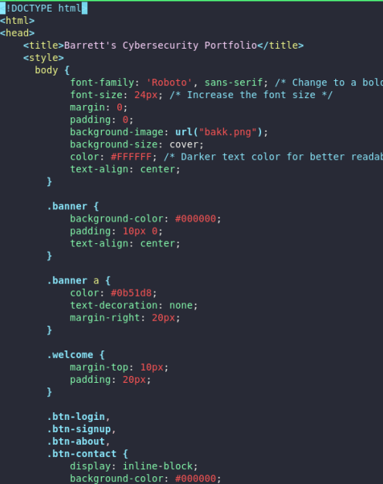
Index.php Code
body: Contains the content of the page, such as text, the background and other styling options
.banner: Styles the banner section, which contains links for Login, Sign Up, Projects, and About
.welcome: Styles the welcome section, which contains the welcome message and a prompt to login
.btn-login, .btn-signup, etc.: Styles the Login, Sign Up, Projects, and About buttons.

Slide 7
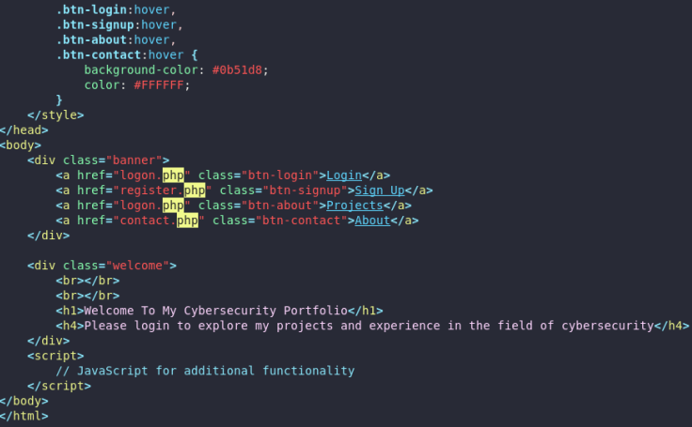
Index.php Code
.btn-login:hover, .btn-signup:hover, etc.: Styles the buttons to change when hovered over
<a>: Defines a hyperlink which is used for the corresponding buttons in the banner section.
<h1> <h4>: These make up the body of the webpage which is styled by the welcome class as seen above in the code
<script>: Here I plan to add more JavaScript to make the website more fluid and dynamic

Slide 8
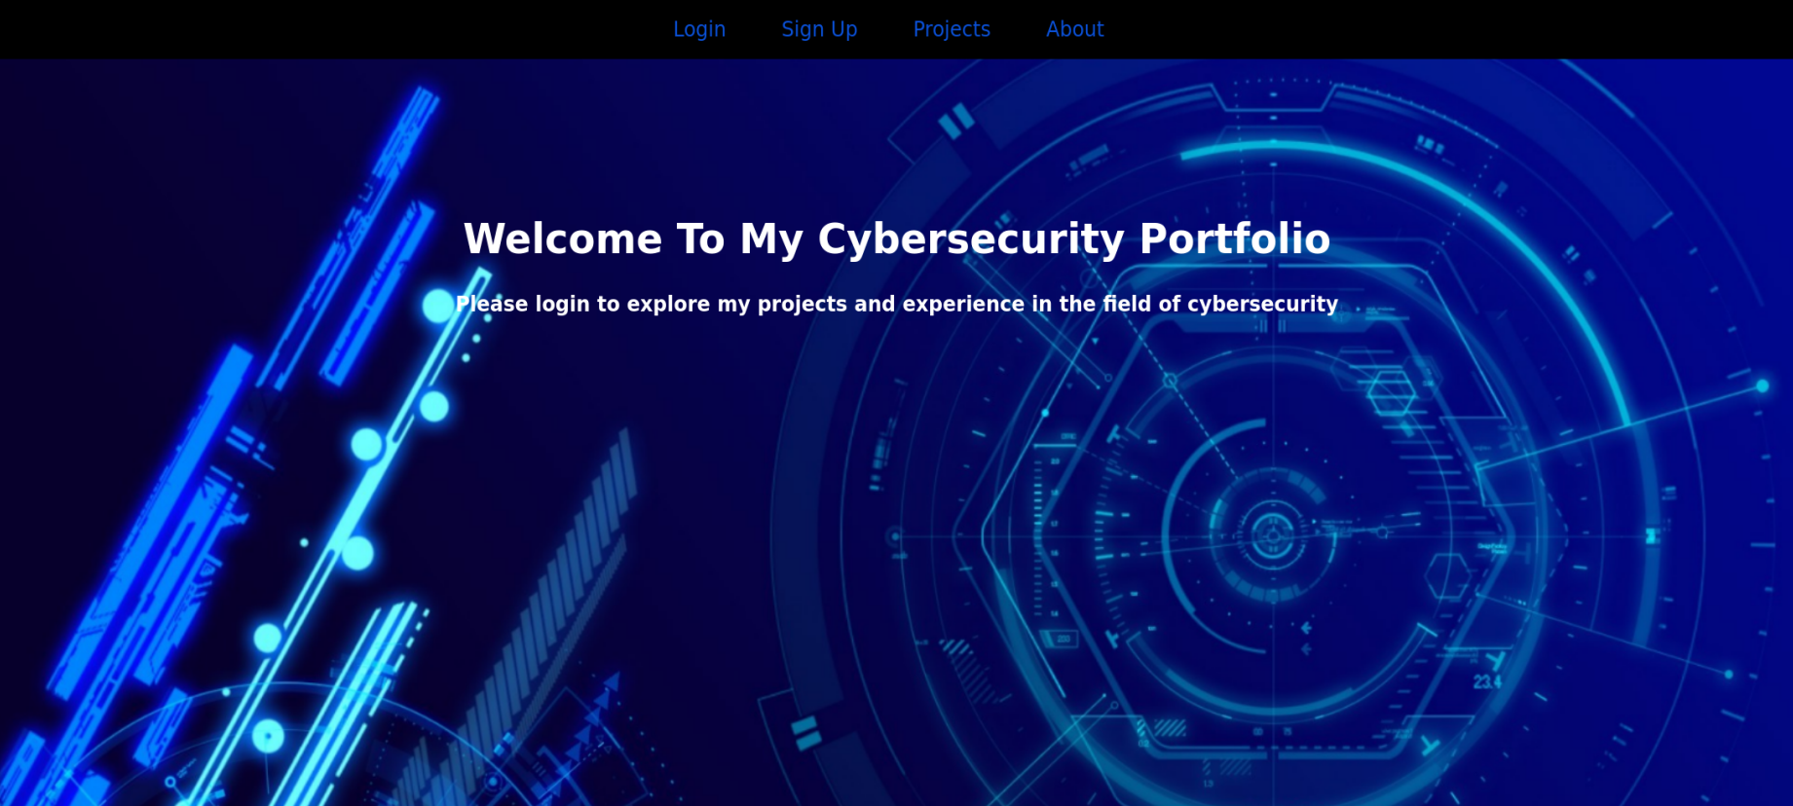
Index.php Webpage
Here users can choose to login if they already have an account or sign up if they have yet to make an account. Users can also choose to visit my projects or about page but must login first. Upon logging in they will be redirected to the home page where they can access any of the previous mentioned pages and more.

Slide 9
Database Information

Slide 10
Database Information
Description:
The database used on my website serves as a crucial component for managing user authentication and storing user-related information. It stores user credentials securely for login purposes, ensuring that only authenticated users can access certain pages. The database also contains user-specific data, such as contact information and roles, which is utilized to personalize the user experience and provide tailored content.
Key Points:
The database manages user roles (e.g., admin, regular user) to control access to certain parts of the website and enforce security measures
It is designed to be scalable, capable of handling a growing number of users and data as the website expands
The database ensures the integrity and security of user data through encryption, access control, and other security measures to protect user privacy

Slide 11
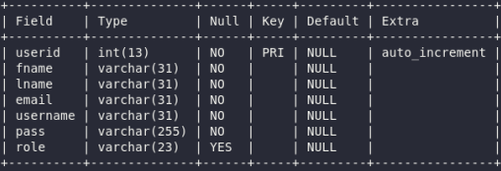
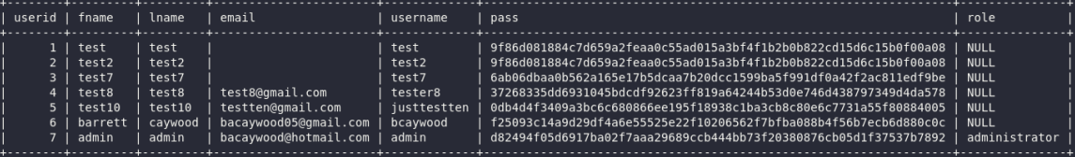
Database

Slide 12
Phptest.php

Slide 13
Phptest.php Information
Description:
This page contains the phpinfo() function, which outputs a comprehensive overview of the PHP environment on the server where the script is executed. This includes information such as PHP version, configuration settings, modules, and more. It's primarily used for debugging and troubleshooting purposes, providing developers with detailed insights into the PHP configuration and environment.
Key Points:
This page is not accessible to the public, as it can expose sensitive server information.

Slide 14
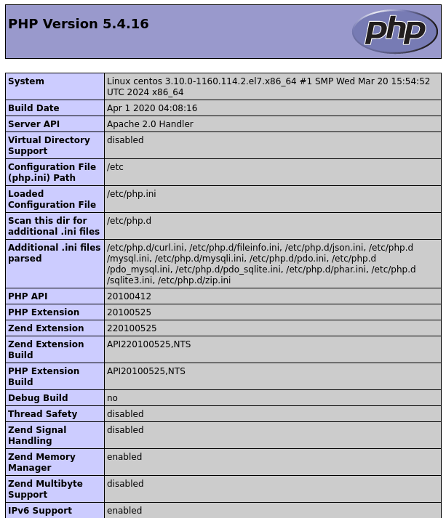
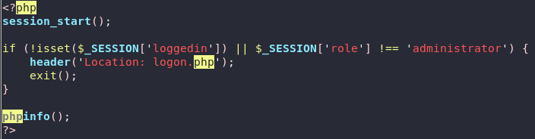
Phptest.php Code
This makes sure that only administrators can view this page
Anyone else who tries to access this page will be redirected to the login page
This is what makes the request for the info page
This is one of the many pages included with the phpinfo() function

Slide 15
Connect.php

Slide 16
Connect.php Information
Description:
This PHP script establishes a connection to the MySQL database named 'users' on the same server. The purpose of this page is to connect to the database to perform various operations such as retrieving user information, updating user details, or inserting new user data.
Key Points:
This webpage uses PHP Data Objects to connect to the MySQL database, which provides a secure and efficient way to interact with databases in PHP
The $options array is used to set attributes for error handling, default fetch mode, and emulation of prepared statements
The try-catch block is used to handle any exceptions that may occur during the database connection process, ensuring that errors are caught and properly managed

Slide 17
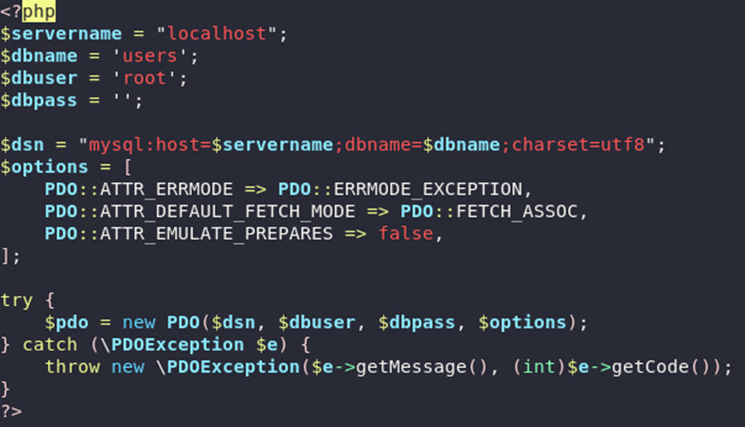
Connect.php Code
These variables store the server's name, database name, database username, and database password
$dsn: This variable stores the Data Source Name for the database connection
$options: This variable is an array that configures the PDO connection.
try: This block of code tries to create a new PDO instance with the specified options.

Slide 18
Register.php
(Account Creation Web Page)

Slide 19
Register.php Information
Description:
This PHP script creates a user registration form and handles the insertion of new user data into a MySQL database. It includes client-side validation for the form fields and redirects the user to the login page upon successful registration.
Key Points:
Uses PHP's PDO extension to connect to a MySQL database and insert user data securely
Implements client-side validation using JavaScript to ensure that the form is filled out correctly before submission
Utilizes session management to prevent logged-in users from accessing the registration page
Provides feedback to the user about the success or failure of the registration process

Slide 20
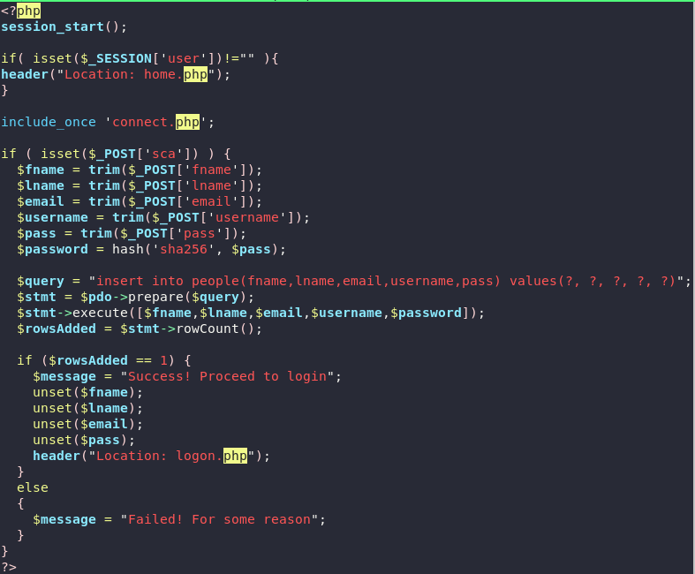
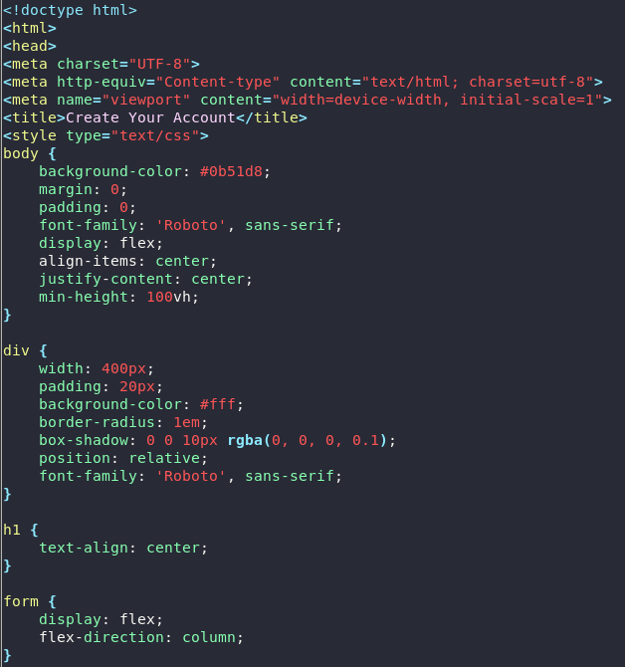
Register.php Code
session_start();: Starts a new session or resumes an existing session
Then it checks if the 'user' session variable is set and redirects to the home.php page if so
Include_once : Includes the 'connect.php' file, which contains the PDO database connection

Slide 21
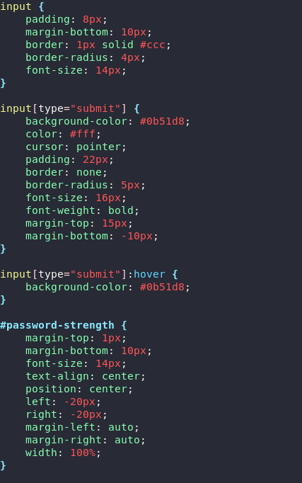
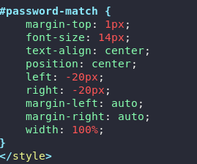
Register.php Code
This provides the layout and styling for the submit button
Here it styles the password strength meter
This is the styling for the prompt that tells the user if the password they entered match

Slide 22
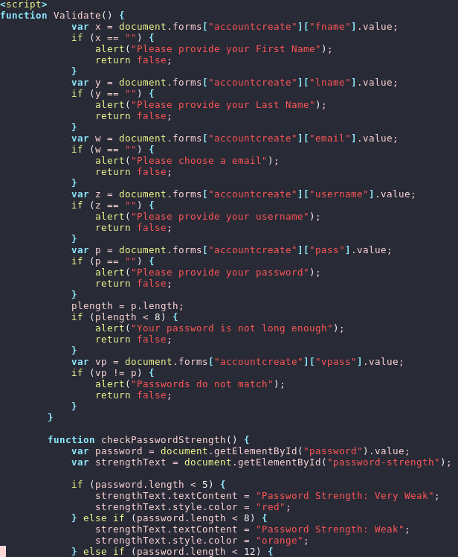
Register.php Code
Here the input fields for the account creation are made
Unlike the other fields the password field requires a minimum length for security purposes
This function checks the passwords length and displays the strength level to the user

Slide 23
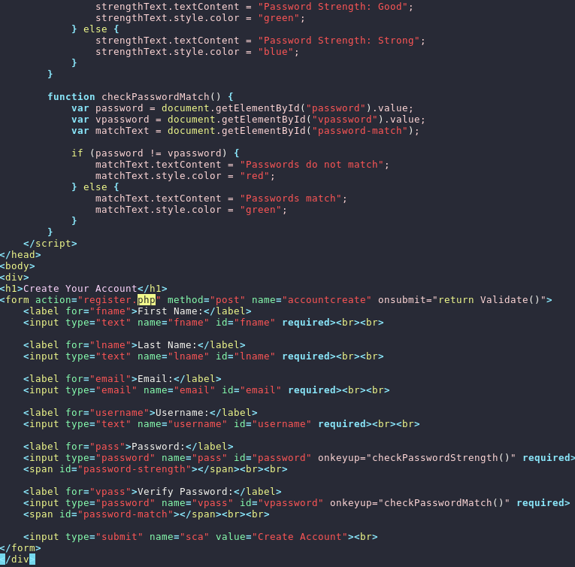
Register.php Code
This function assures that passwords entered by the user match before insertion to the database
Here all the input fields and functions covered are put into there place

Slide 24
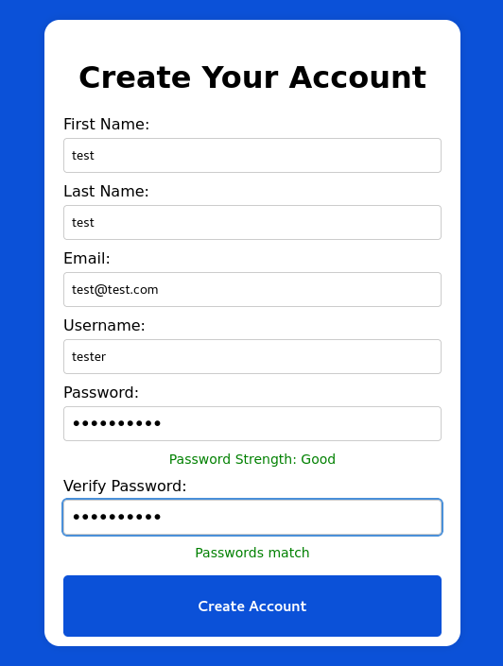
Register.php Webpage
Here new users can create an account. It includes fields for the user's first name, last name, email, username, password, and password verification. Client-side JavaScript functions are used for form validation, including checking the password strength and verifying that the passwords match. If registration is successful, the user is redirected to the login page.

Slide 25
Logon.PHP
(Login Webpage)

Slide 26
Logon.php Information
Description:
Here users can log into their account so that they can view my projects and other pages . It includes fields for entering a username and password, along with a submit button to log in. The form is validated using JavaScript to ensure both fields are filled out before submission. If the login is successful, the user is redirected to the home.php page. Otherwise, an error message will be displayed.
Key Points:
Passwords are hashed using the SHA-256 algorithm before being stored
Provides a link to create a new account if the user doesn't have one
Displays an error message if the login is unsuccessful

Slide 27
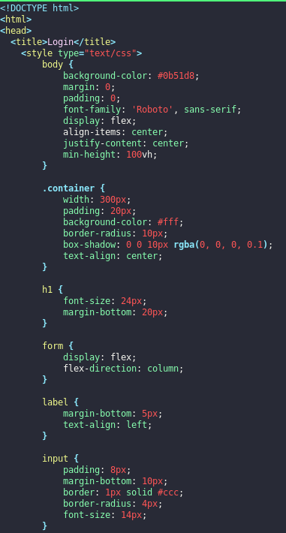
Logon.php Code
This sets the blue background and other styling choices for the webpage
This defines the styling for the body, container, form, labels, inputs, and error message elements box shadow, and text alignment.

Slide 28
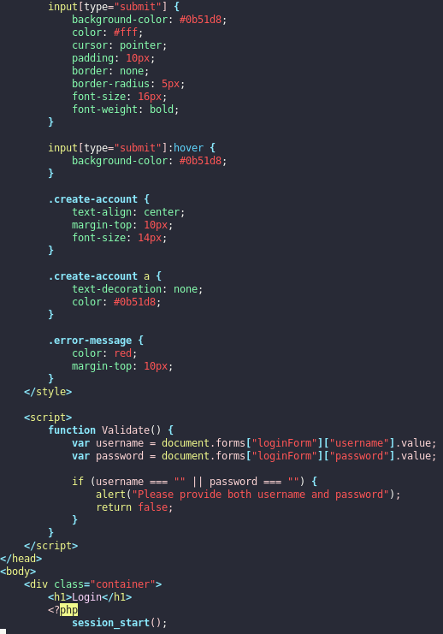
Logon.php Code
This styles the submission button and the option to create and account instead
This function validates that user has provided both the username and password

Slide 29
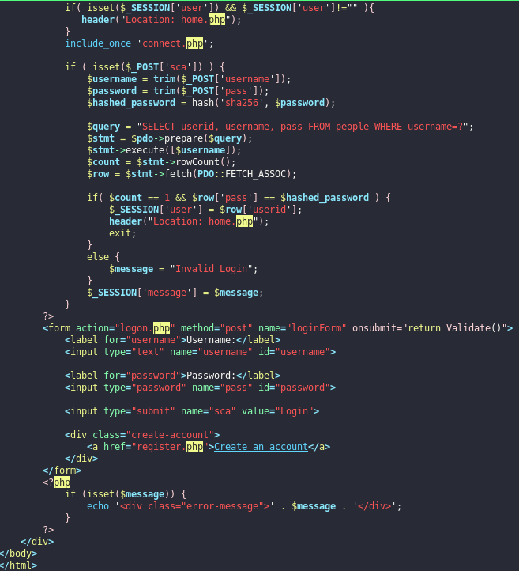
Logon.php Code
Here the login function is connected to the database to make the corresponding changes
If the credentials are found in the database, the user is redirected to home.php

Slide 30
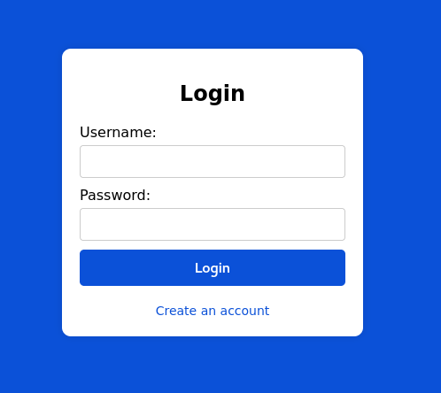
Logon.php
The webpage features a login form where it employs client-side form validation with JavaScript to ensure both the username and password fields are completed. User authentication is managed through PHP sessions, with user credentials retrieved from the MySQL database. Passwords are hashed using the SHA-256 algorithm before storage for enhanced security. Upon successful login, users are redirected to the home.php page. If the login attempt fails, an error message is displayed. Additionally, a link is provided for users to create a new account if they do not have one.

Slide 31
Home.php

Slide 32
Home.php Information
Description:
This is the actual project portfolio page that includes a header with a welcome message, title, and the logout, about me and settings buttons. The page also contains a container with buttons linking to various projects.
Key Points:
The page starts a session to manage user authentication. If a user is not logged in, they are redirected to the index.php page.
The page interacts with the database to fetch user information based on the session user ID. It uses this information to determine the user's role and display the appropriate links in the subheader.
The subheader includes links for logging out, accessing the contact page (About Me), and accessing settings (either adminset.php for administrators or setting.php for other users)

Slide 33
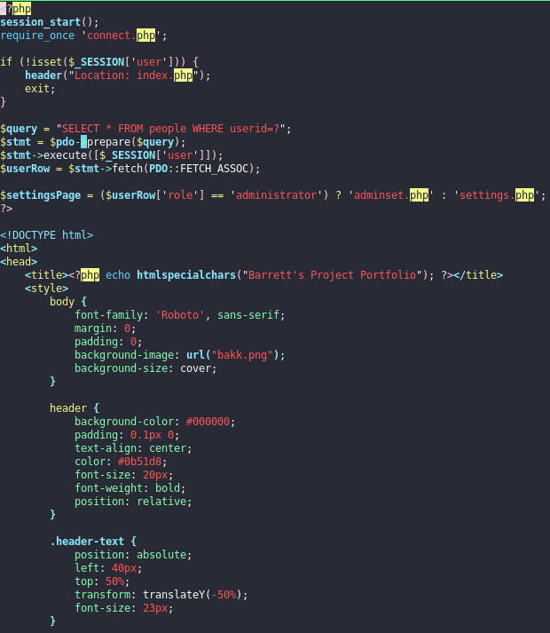
Home.php Code
Checks if the user is not logged in and redirects to the index.php page if not.
First the session is started and connected to the database
Then it checks if the user is not logged in and redirects to the index.php page if not.
Here it starts to define the styles for the elements of the page

Slide 34
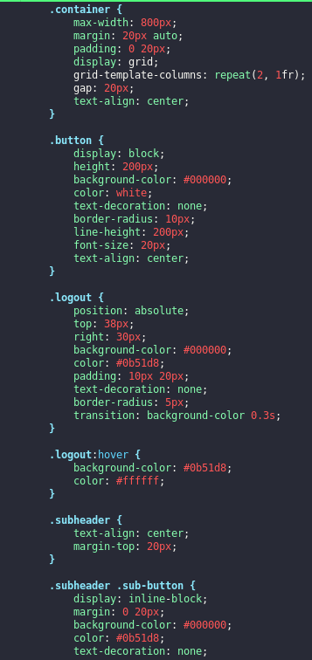
Home.php Code
Here the styles for the logout and about buttons are defined
Here it defines styles for the subheader, including text alignment and margin.

Slide 35
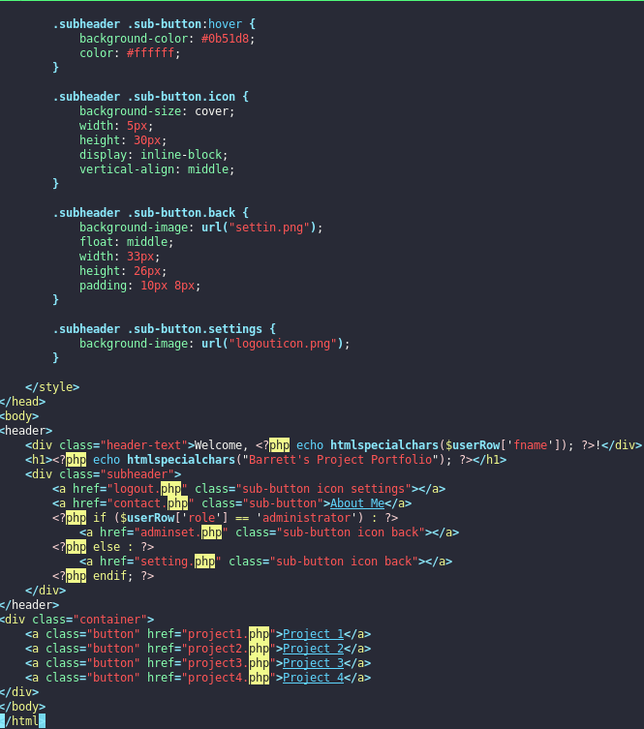
Home.php Code
Sub header and corresponding buttons styles are continued
Here the page structure starts to be defined
Included in the header content is the header with the welcome message, project portfolio title, and buttons that link to other pages.
Here is where the projects will be put so that users can see my work

Slide 36
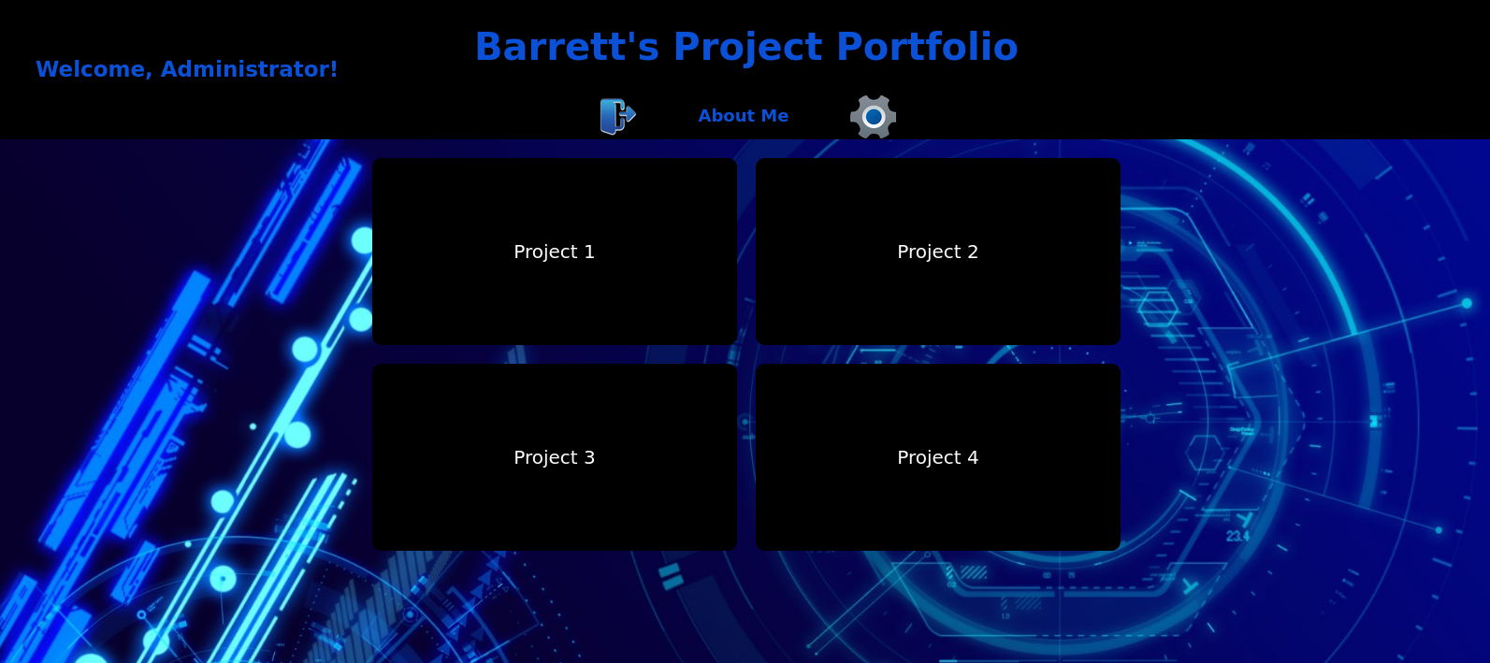
Home.php Webpage
The project portfolio includes a header that features a personalized welcome message and title in the header. The navigation is intuitive, with a subheader offering links to different sections based on the user's role, such as the contact page and settings. The main content area showcases the user's projects with large, visually appealing buttons, making it easy for visitors to explore.

Slide 37
Contact.php

Slide 38
Contact.php Information
Description:
This webpage serves as an "About Me" section, providing visitors with a brief insight into my professional background. Below is my contact information which includes my email and links to my LinkedIn and GitHub pages.
Key Points:
The page features a home button with an icon, providing easy navigation back to the home page
The page checks if the user is authenticated before allowing access, ensuring that only logged-in users can view the content
The page has a clean and organized layout, with a container for content and styled boxes for different sections

Slide 39
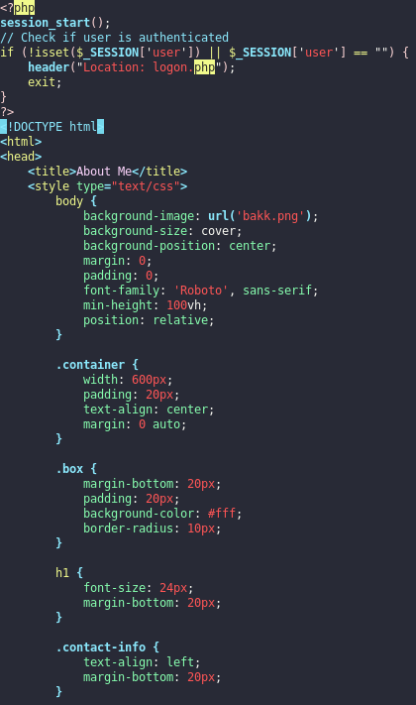
Contact.php Code
Here a new session is started or resumes an existing one, if the user is not logged in yet they are redirected to the login page
Styles are defined for the entire document, including the body, container, boxes, headings, contact information, and buttons

Slide 40
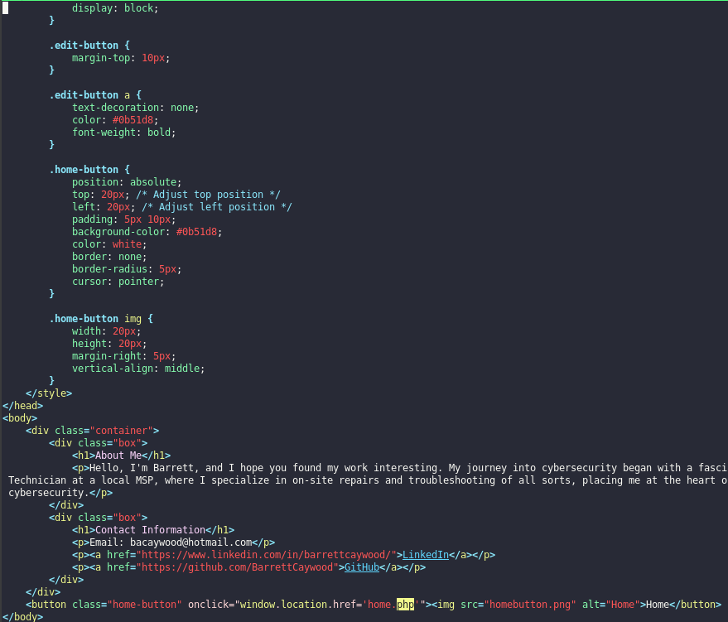
Contact.php Code
Stylings for the contact information and about section of the page are defined
Styling for the home button is defined here
Here the page is structured with about me at the top with my contact information under

Slide 41
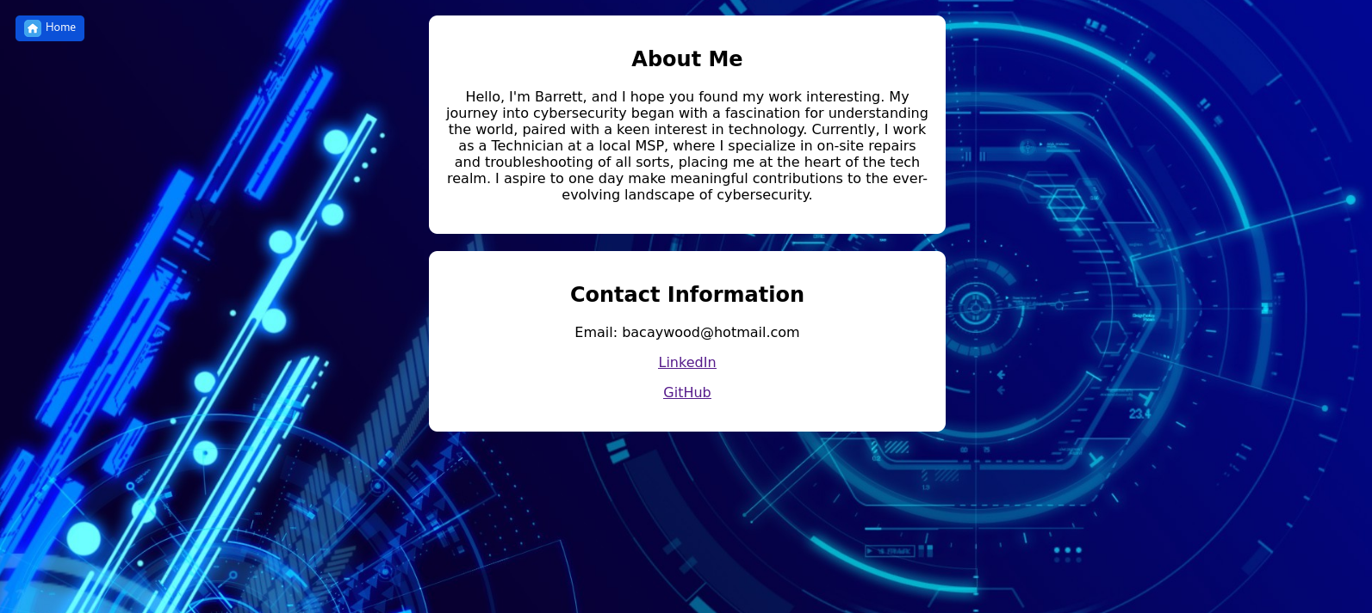
Contact.php Webpage
This page presents my professional background and contact information in a visually appealing and user-friendly manner, showcasing my skills and interests in cybersecurity. It also includes a “Home” button that redirects users back to the home page.

Slide 42
Setting.php

Slide 43
Setting.php Information
Description:
The settings page is a user-friendly interface for updating account information which includes username, email, and password. Each section has a "Save" button for submitting updates, and a message area provides feedback on the outcome of the operations. A "Home" button allows users to easily return back to the home page.
Key Points:
A message displays feedback on the outcome of the update operations (e.g., "Username Saved")
Each input form has a "Save" button to submit the changes
The "Home" button at the top left corner allows the user to return back to the main page

Slide 44
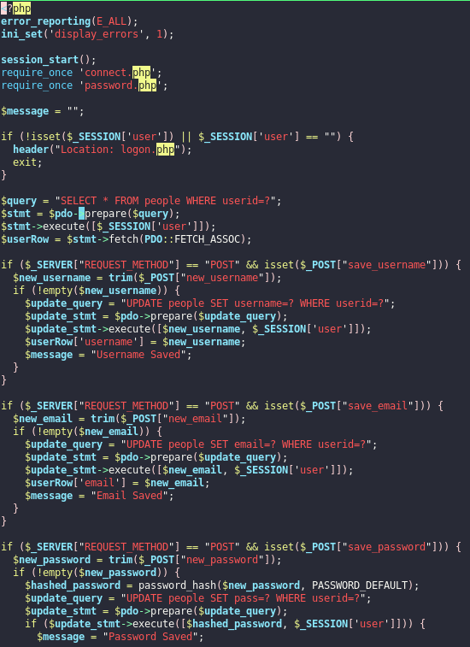
Setting.php Code
The code begins with error reporting and session start to handle any potential errors and manage user
Soon after a statement includes a file that establishes a connection to the MySQL
The code checks if a user is logged in by verifying the existence of a session user variable.
If not, it redirects the user to the login page

Slide 45
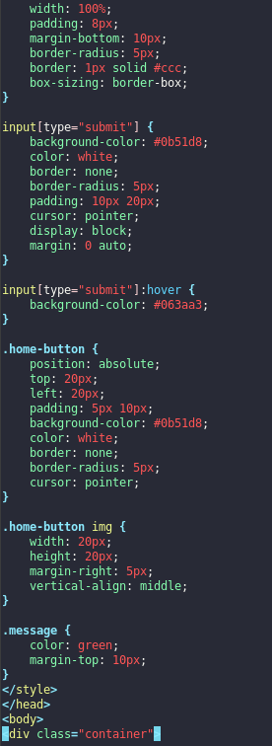
Setting.php Code
The background image, font, and home and submit button styles are defined to enhance the overall look and feel of the page
The styling for the message that updates the user on their changes is also defined here

Slide 46
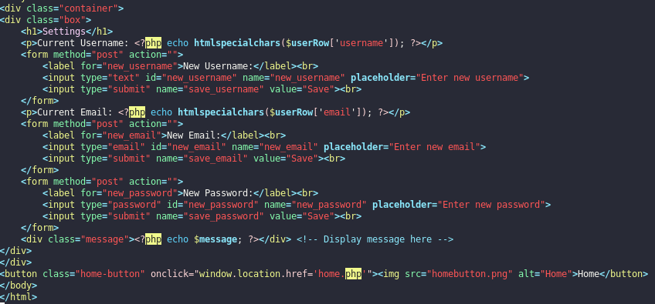
Setting.php Code
The HTML section includes forms for updating username, email, and password. Each form contains input fields for the new value and a submit button.
The message area displays feedback messages (e.g., "Username Saved") to inform the user of the outcome of their actions.
A "Home" button is added a the bottom of the page, allowing users to return to the home page easily.

Slide 47
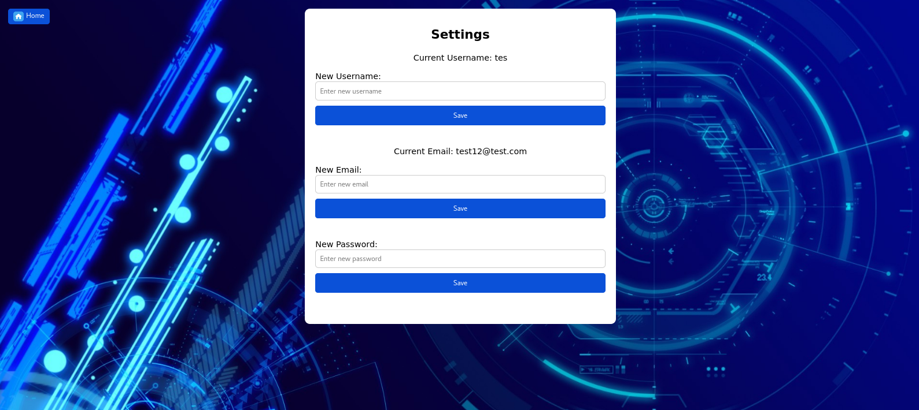
Setting.php Webpage
The webpage is a user-friendly interface for updating account information, including username, email, and password. It features a simple layout with input fields for each type of information and a "Save" button to submit changes. Feedback messages are displayed to inform users of their changes. Additionally, a "Home" button is provided for easy navigation back to the home page.

Slide 48
Adminset.php
(Administrator Settings)

Slide 49
Adminset.php Information
Description:
This webpage is an administrator settings page designed for managing user accounts. It includes functionality to update usernames, emails, passwords, and user roles. The page features a clean and intuitive layout with input fields and dropdown menus for making changes, along with feedback messages to inform administrators of the outcomes of their actions. A "Home" button is also included to allow for easy navigation back to the home page.
Key Points:
The code checks if the logged-in user is an administrator. If not, it redirects them to the landing page
In addition to updating the username, email, and password, administrators can also change a user's role between "User" and "Administrator”
Feedback messages are displayed to inform administrators of the outcome of their actions

Slide 50
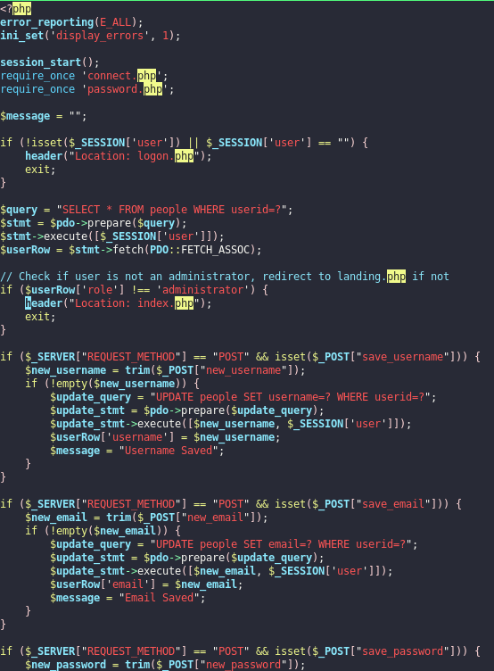
Adminset.php Code
The code starts with error reporting and session start to handle errors and manage user sessions
Then establishes a connection to the MySQL database
It checks if a user is logged in and redirects to the login page if not if n
It redirects non-administrators to the landing page to restrict access to the administrator settings page

Slide 51
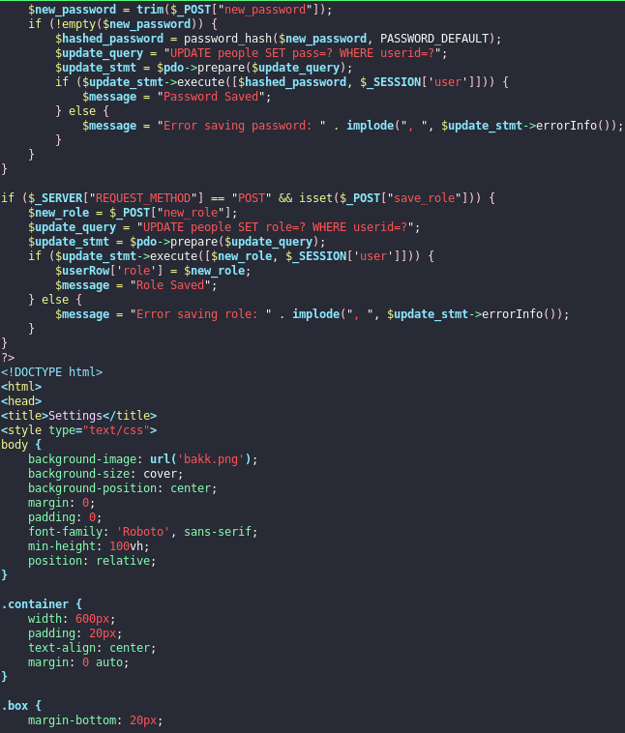
Adminset.php Code
It hashes the new password and updates it in the database, displaying a feedback message based on the outcome
Then it updates the user's role in the database based on the selection made in the dropdown menu
Background image, font, and button styles are used to enhance the overall design.

Slide 52
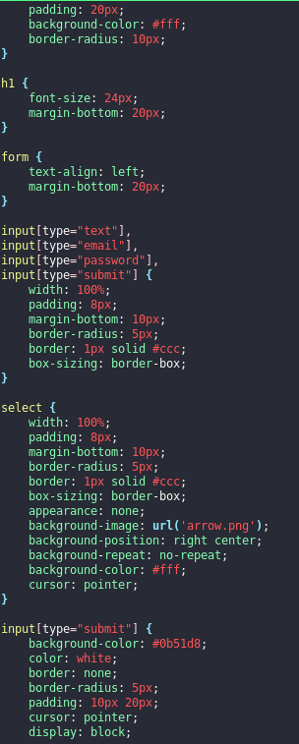
Adminset.php Code
This section defines styles for the body, container, input fields, buttons, and update message displayed to users
Here the style for the drop-down menu to choose the users role is defined
The save button style is defined here

Slide 53
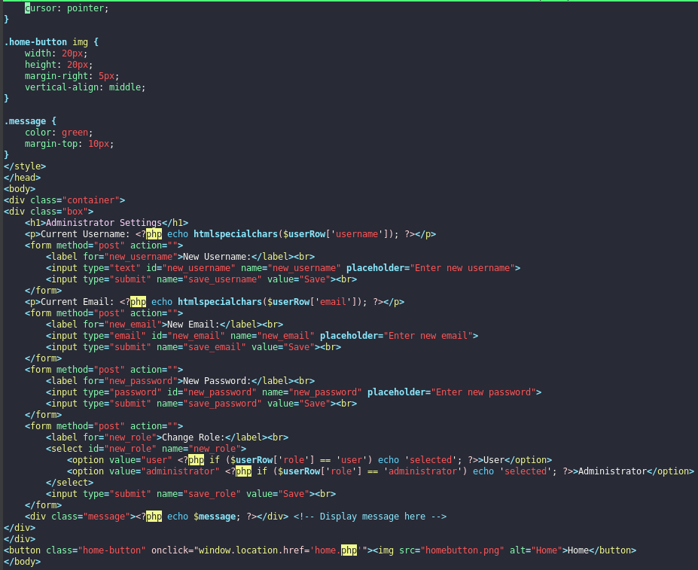
Adminset.php Code
The HTML section includes forms for updating username, email, password, and role, each with input fields or dropdown menus and a "Save" button
Here the message area displays feedback messages (e.g., "Username Saved") to inform administrators of the outcome of their actions
A "Home" button is added at the bottom of the page, allowing administrators to return to the home page easily

Slide 54
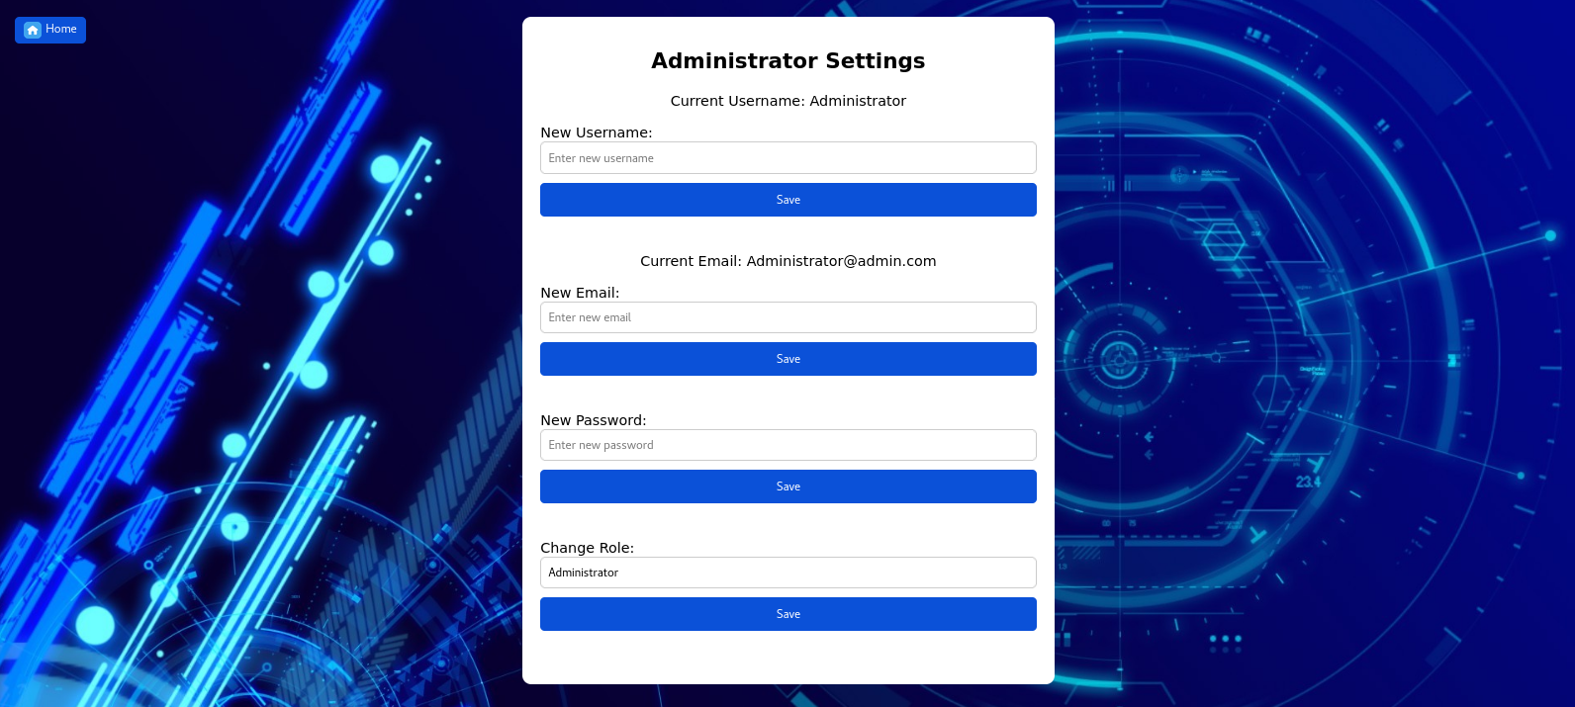
Adminset.php Webpage
This webpage is a secure and user-friendly platform designed for administrators to manage user accounts and roles. It features error reporting and session handling for secure authentication, ensuring only authorized users can access and make changes. The layout includes sections for updating usernames, emails, passwords, and user roles. Feedback messages are displayed to inform administrators of the outcome of their actions.

Slide 55
Logout.php

Slide 56
Logout.php Information
Description:
This PHP script serves as a logout page for a website. When accessed, it initiates a session, unsets and destroys the 'user' session variable, logging the user out. It then redirects the user to the landing page.
Key Points:
Utilizes sessions to manage user authentication.
Unsets and destroys the session variable, ensuring the user is logged out.
Redirects the user to the homepage after logout.
Ensures a secure logout process to protect user data.

Slide 57
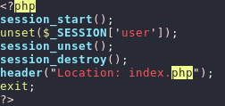
Logout.php Code
It begins by starting the session and then unsetting the 'user' session variable, logging the user out.
The next function is called to remove all session variables, and after it is used to destroy the session data.
After the logout process is complete, the script redirects the user to the landing page.

Slide 58
404 Error Page

Slide 59
404error.php Information
Description:
This webpage is a custom 404 error page, which is displayed when a user tries to access a page that does not exist on the website.
Key Points:
It features a large "404" heading to clearly indicate the error, along with a message reassuring the user and offering a link to return to the homepage
The page also features Comic Sans MS font and a humorous image of a sad dog

Slide 60
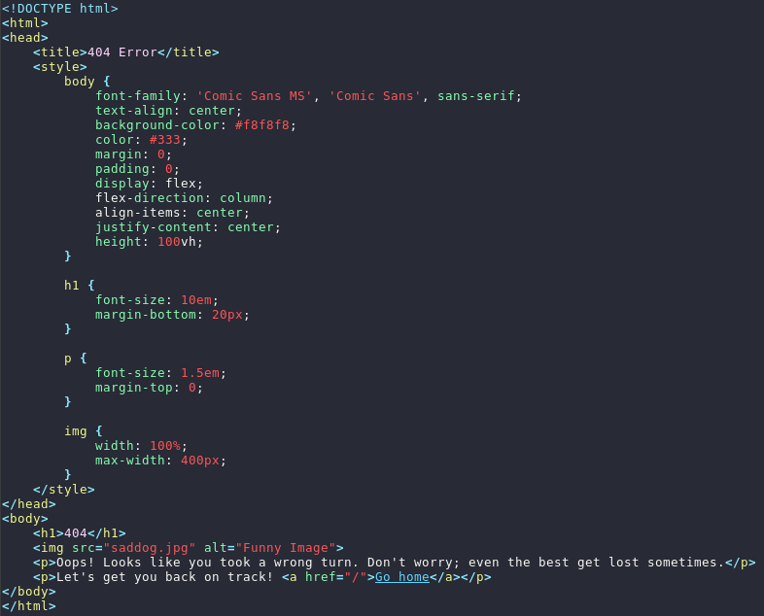
404error.php Code
Here the styling for the elements on the page is defined
The heading section includes a large "404" heading to clearly indicate the error
The sad dog image is applied for visual appeal, as well as a message that reassures the user with a humorous touch

Slide 61
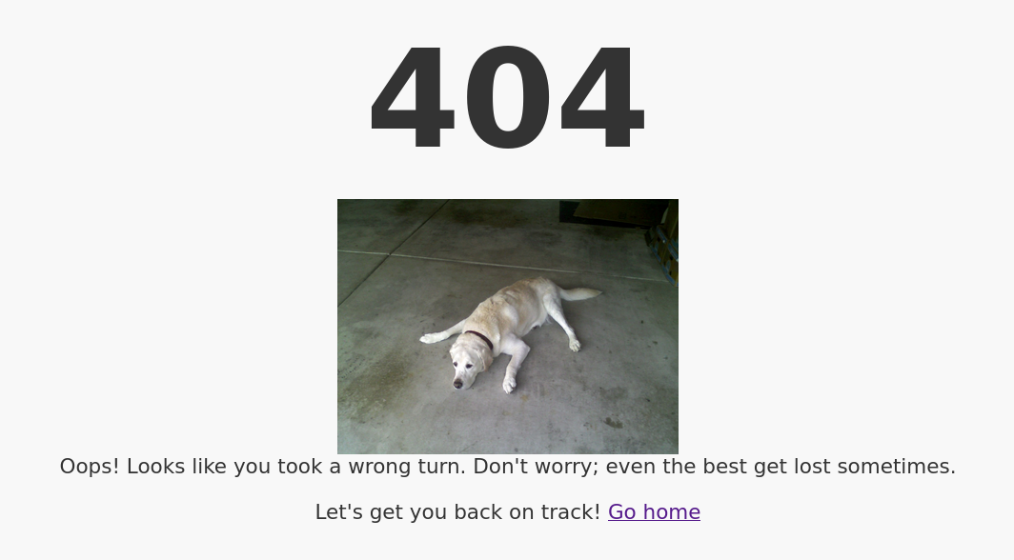
404error.php Webpage
This webpage is a custom 404 error page, which is displayed when a user tries to access a page that does not exist on the website.

